Slide 1
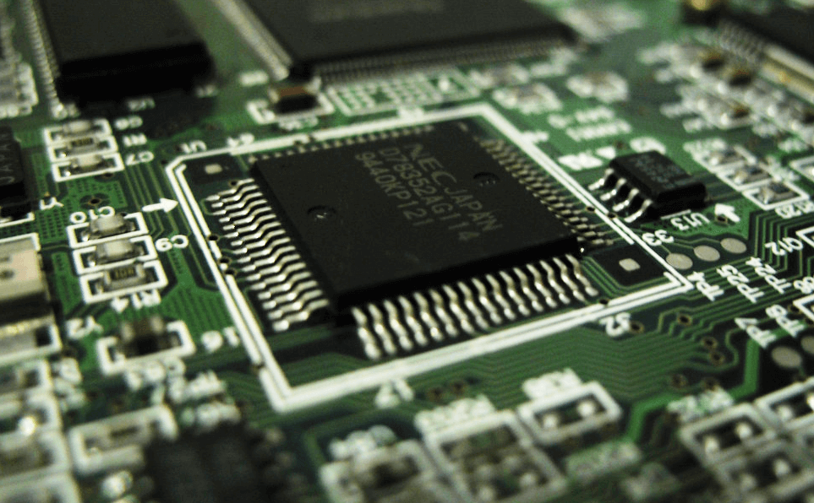
8085 Microprocessor
Dr. Manju Khurana
Assistant Professor, CSED
TIET, Patiala
manju.khurana@thapar.edu

Slide 2
Instruction Set
Introduction to Microprocessor Based Systems Design
Instructions have been classified into five following groups:
Data Transfer Group
Arithmetic Group
Logical Group
Branch Control Group
I/O and Machine Control Group
2

Slide 3
Instruction Formats
Introduction to Microprocessor Based Systems Design
Each instruction has two parts:
Opcode (operation code)- The first part is the task or operation to be performed.
Operand - The second part is the data to be operated on. Data can be given in various forms.
It can specify in various ways: may include 8 bit/16 bit data, an internal register, memory location or 8 bit /16 bit address.
For Eg.:
MVI A,02H
Opcode
Operand
3

Slide 4
Introduction to Microprocessor Based Systems Design
NOTATIONS | MEANING
M | Memory location pointed by HL register pair
r | 8- bit register
rp | 16-bit register
rs | Source register
rd | Destination register
addr | 16-bit address
4

Slide 5
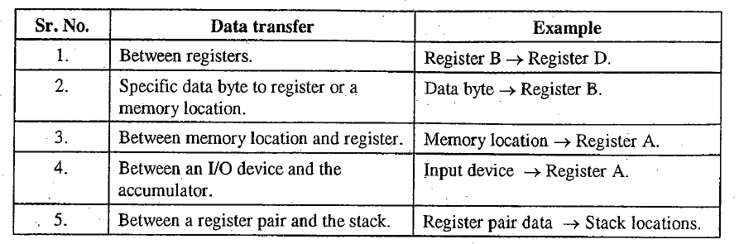
Data Transfer Instructions
Introduction to Microprocessor Based Systems Design
These instructions move data between registers, or between memory and registers.
These instructions copy data from source to destination.
While copying, the contents of source are not modified.
5

Slide 6
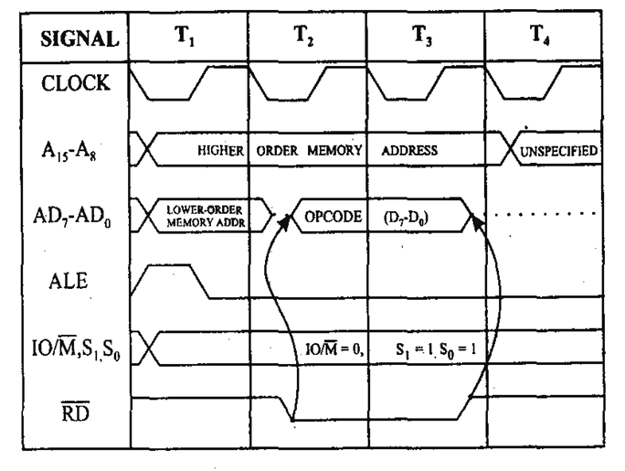
1. MOV r₁, r₂
Introduction to Microprocessor Based Systems Design
Move the contents of one register to another register.
[r₁] ← [r₂]
States: 4
Flags: None
Addressing: Register
Machine Cycles: 1
6

Slide 7
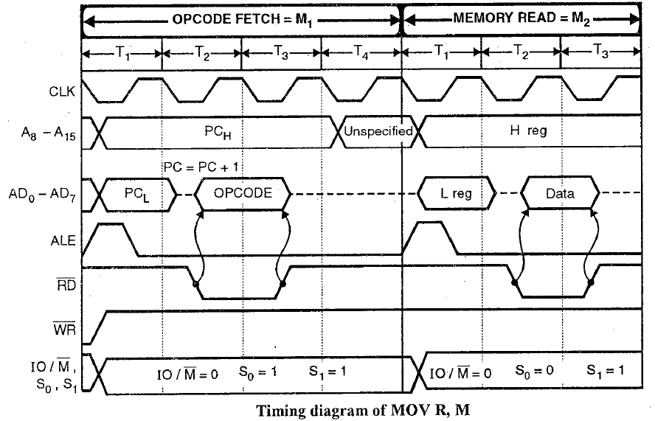
2. MOV r, M
Introduction to Microprocessor Based Systems Design
Move the contents of memory to register.
[r] ← [H-L]
States: 7
Flags: None
Addressing: Register Indirect
Machine Cycles: 2
7

Slide 8
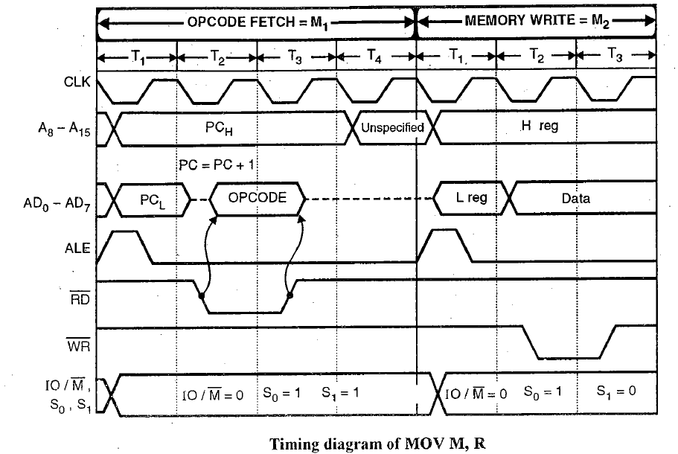
3. MOV M, r
Introduction to Microprocessor Based Systems Design
Move the contents of register to memory.
[H-L] ← [r]
States: 7
Flags: None
Addressing: Register Indirect
Machine Cycles: 2
8

Slide 9
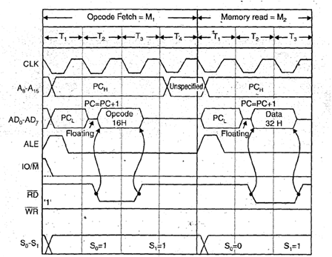
4. MVI r, data
Introduction to Microprocessor Based Systems Design
Move immediate data to register.
[r] ← data
States: 7
Flags: None
Addressing: Immediate
Machine Cycles: 2
9

Slide 10
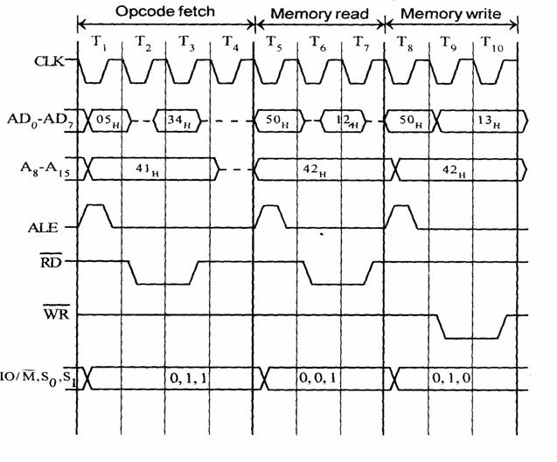
5. MVI M, data
Introduction to Microprocessor Based Systems Design
Move immediate data to memory.
[H-L] ← data
States: 10
Flags: None
Addressing: Immediate/
Register Indirect
Machine Cycles: 3
10

Slide 11
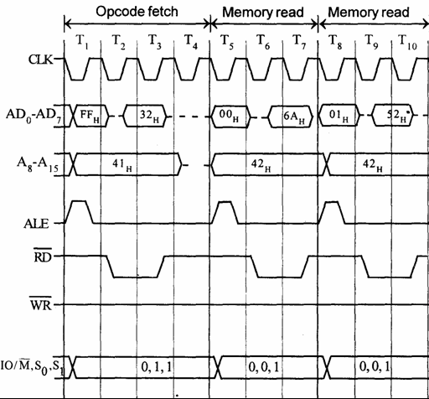
6. LXI rp, data 16
Introduction to Microprocessor Based Systems Design
Load register pair immediate.
[rp] ← data 16 bits
[rh] ← 8 MSBs of data
[rl] ← 8 LSBs of data
States: 10
Flags: None
Addressing: Immediate
Machine Cycles: 3
11

Slide 12
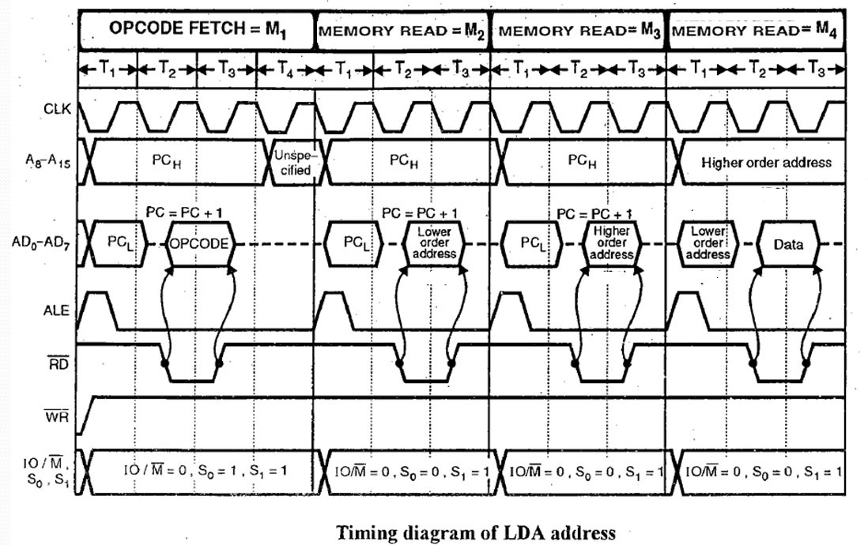
7. LDA addr
Introduction to Microprocessor Based Systems Design
Load Accumulator direct.
[A] ← addr
States: 13
Flags: None
Addressing: direct
Machine Cycles: 4
12

Slide 13
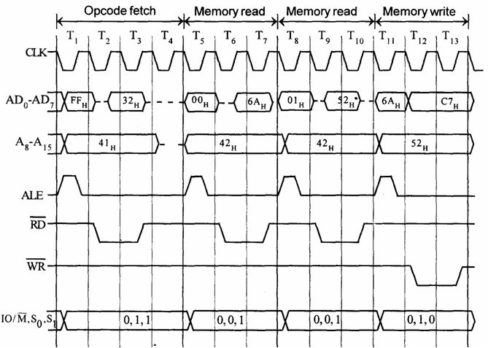
8. STA addr
Introduction to Microprocessor Based Systems Design
Store Accumulator direct.
[addr] ← [A]
States: 13
Flags: None
Addressing: direct
Machine Cycles: 4
13

Slide 14
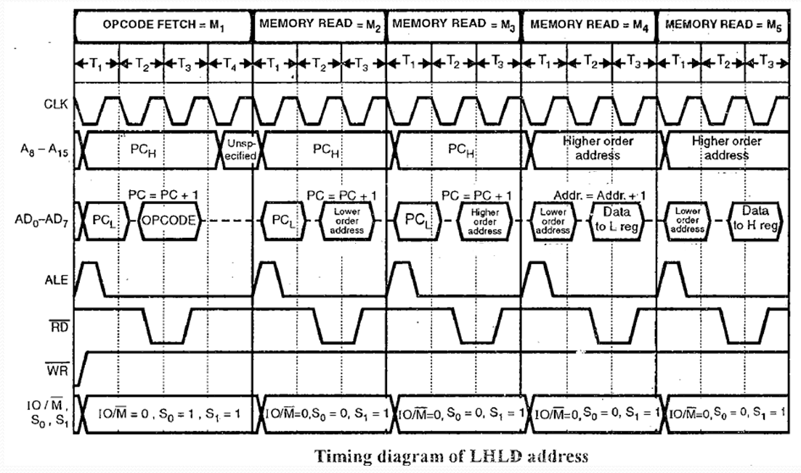
9. LHLD addr
Introduction to Microprocessor Based Systems Design
Load H-L pair direct.
[L] ← [addr]
[H] ←[addr+1]
States: 16
Flags: None
Addressing: direct
Machine Cycles: 5
14

Slide 15
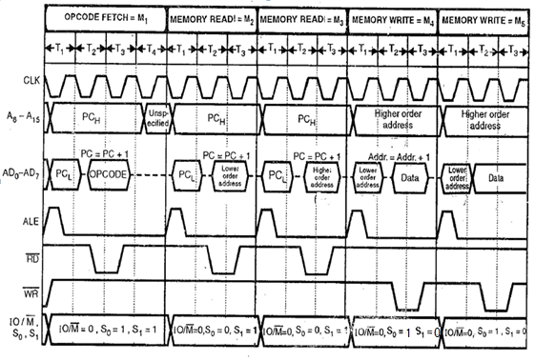
10. SHLD addr
Introduction to Microprocessor Based Systems Design
Store H-L pair direct.
[addr] ← [L]
[addr+1] ← [H]
States: 16
Flags: None
Addressing: direct
Machine Cycles: 5
15

Slide 16
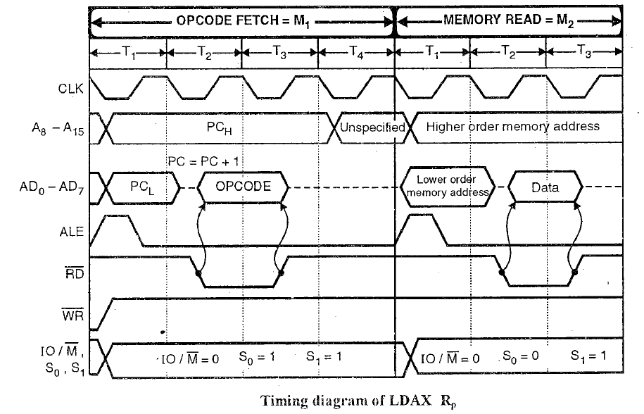
11. LDAX rp
Introduction to Microprocessor Based Systems Design
Load accumulator indirect.
[A] ← [rp]
States: 7
Flags: None
Addressing: Register indirect
Machine Cycles: 2
16

Slide 17
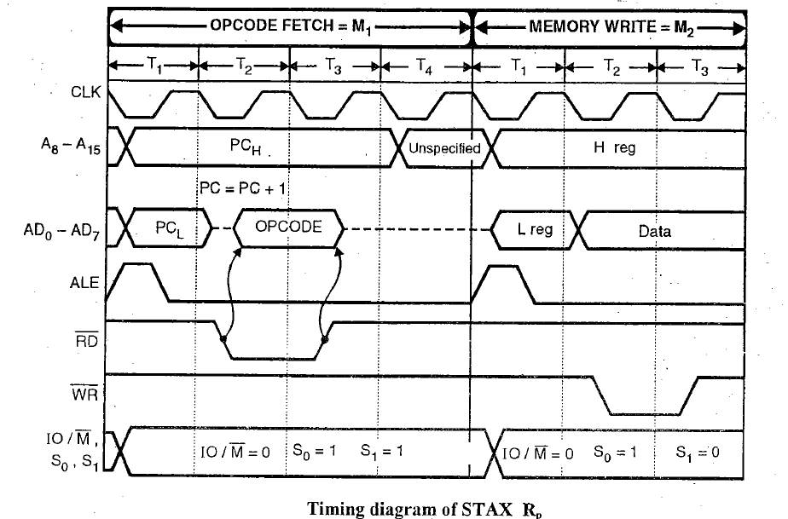
12. STAX rp
Introduction to Microprocessor Based Systems Design
Store accumulator indirect.
[rp] ← [A]
States: 7
Flags: None
Addressing: Register indirect
Machine Cycles: 2
17

Slide 18
13. XCHG
Introduction to Microprocessor Based Systems Design
Exchange the contents of
H-L pair with D-E pair.
[H-L] ↔ [D-E]
States: 4
Flags: None
Addressing: Register
Machine Cycles: 1
18

Slide 19


Slide 20
8085 Microprocessor
Dr. Manju Khurana
Assistant Professor, CSED
TIET, Patiala
manju.khurana@thapar.edu

Slide 21
Arithmetic Instructions
Introduction to Microprocessor Based Systems Design
These instructions perform the operations like:
Addition
Subtraction
Increment
Decrement
21

Slide 22
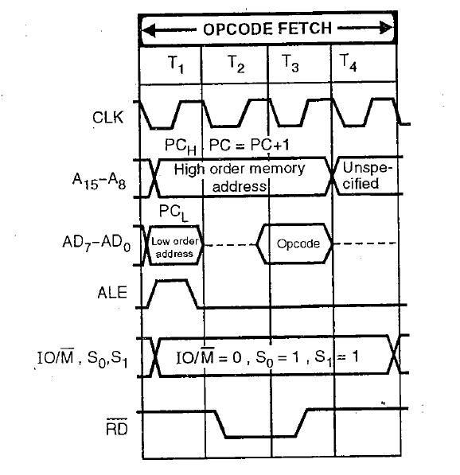
1. ADD r
Introduction to Microprocessor Based Systems Design
Add register to accumulator.
[A] ← [A] + [r]
States: 4
Flags: all
Addressing: Register
Machine Cycles: 1
22

Slide 23
2. SUB r
Introduction to Microprocessor Based Systems Design
Subtract register from accumulator.
[A] ← [A] - [r]
States: 4
Flags: all
Addressing: Register
Machine Cycles: 1
23

Slide 24
3. ADD M
Introduction to Microprocessor Based Systems Design
Add memory to
accumulator.
[A] ← [A] + [H-L]
States: 7
Flags: all
Addressing: Register Indirect
Machine Cycles: 2
24

Slide 25
4. SUB M
Introduction to Microprocessor Based Systems Design
Subtract memory from
accumulator.
[A] ← [A] - [H-L]
States: 7
Flags: all
Addressing: Register Indirect
Machine Cycles: 2
25

Slide 26
5. ADC r
Introduction to Microprocessor Based Systems Design
Add register with carry to accumulator.
[A] ← [A] + [r] + [CS]
States: 4
Flags: all
Addressing: Register
Machine Cycles: 1
26

Slide 27
6. SBB r
Introduction to Microprocessor Based Systems Design
Subtract register from accumulator
with borrow.
[A] ← [A] - [r] - [CS]
States: 4
Flags: all
Addressing: Register
Machine Cycles: 1
27

Slide 28
7. ADC M
Introduction to Microprocessor Based Systems Design
Add memory with carry
to accumulator.
[A] ← [A] + [H-L] + [CS]
States: 7
Flags: all
Addressing: Register Indirect
Machine Cycles: 2
28

Slide 29
8. SBB M
Introduction to Microprocessor Based Systems Design
Subtract memory from
Accumulator with borrow.
[A] ← [A] - [H-L] - [CS]
States: 7
Flags: all
Addressing: Register Indirect
Machine Cycles: 2
29

Slide 30
9. ADI data
Introduction to Microprocessor Based Systems Design
Add immediate data
to accumulator.
[A] ← [A] + data
States: 7
Flags: all
Addressing: Immediate
Machine Cycles: 2
30

Slide 31
10. SUI data
Introduction to Microprocessor Based Systems Design
Subtract immediate data
from accumulator.
[A] ← [A] - data
States: 7
Flags: all
Addressing: Immediate
Machine Cycles: 2
31

Slide 32
11. ACI data
Introduction to Microprocessor Based Systems Design
Add with carry immediate
data to accumulator.
[A] ← [A] + data +[CS]
States: 7
Flags: all
Addressing: Immediate
Machine Cycles: 2
32

Slide 33
12. SBI data
Introduction to Microprocessor Based Systems Design
Subtract immediate data from
accumulator with borrow.
[A] ← [A] - data -[CS]
States: 7
Flags: all
Addressing: Immediate
Machine Cycles: 2
33

Slide 34
13. INR r
Introduction to Microprocessor Based Systems Design
Increment register content.
[r] ← [r] + 1
States: 4
Flags: all except carry flag
Addressing: Register
Machine Cycles: 1
34

Slide 35
14. DCR r
Introduction to Microprocessor Based Systems Design
Decrement register content.
[r] ← [r] - 1
States: 4
Flags: all except carry flag
Addressing: Register
Machine Cycles: 1
35

Slide 36
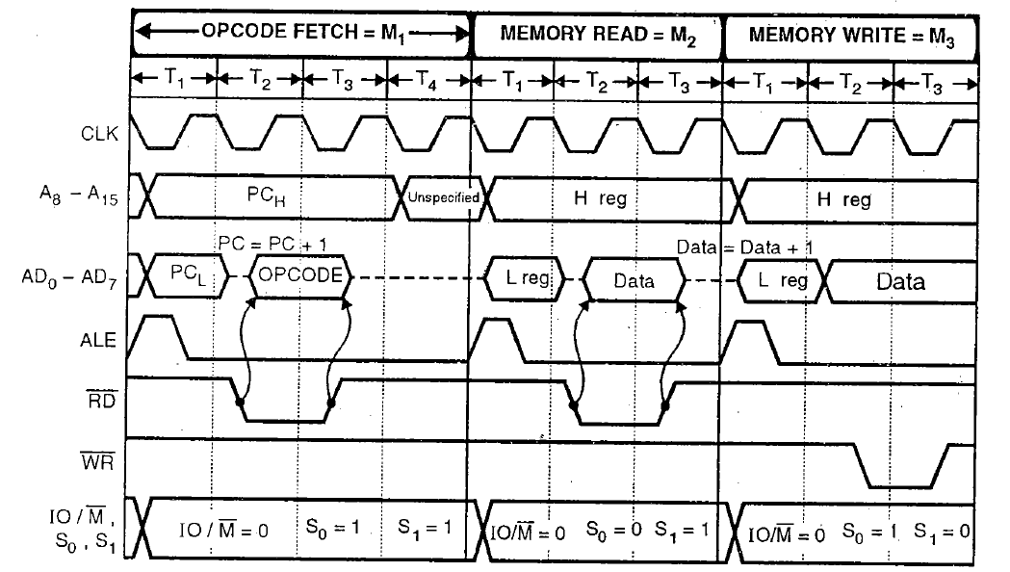
15. INR M
Introduction to Microprocessor Based Systems Design
Increment memory content.
[H-L] ← [H-L] + 1
States: 10
Flags: all except carry flag
Addressing: Register Indirect
Machine Cycles: 3
36

Slide 37
16. DCR M
Introduction to Microprocessor Based Systems Design
Decrement memory content.
[H-L] ← [H-L] - 1
States: 10
Flags: all except carry flag
Addressing: Register Indirect
Machine Cycles: 3
37

Slide 38
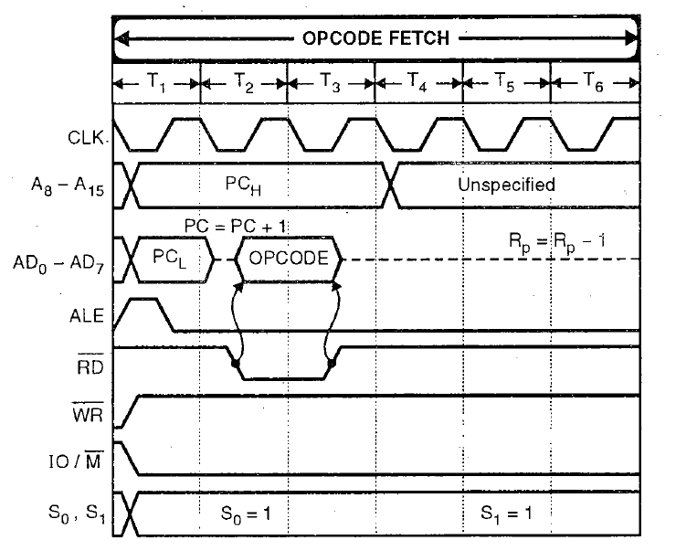
17. INX rp
Introduction to Microprocessor Based Systems Design
Increment register pair.
[rp] ← [rp] + 1
States: 6
Flags: None
Addressing: Register
Machine Cycles: 1
38

Slide 39
18. DCX rp
Introduction to Microprocessor Based Systems Design
Decrement register pair.
[rp] ← [rp] - 1
States: 6
Flags: None
Addressing: Register
Machine Cycles: 1
39

Slide 40
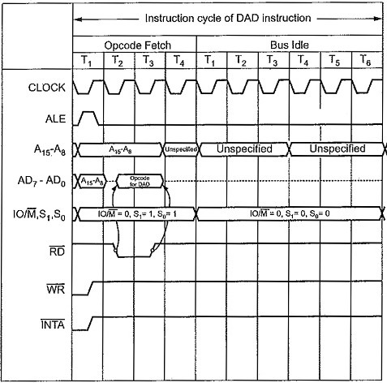
19. DAD rp
Introduction to Microprocessor Based Systems Design
Add register pair to H-L pair.
[H-L] ← [H-L] +[rp]
States: 10
Flags: CS
Addressing: Register
Machine Cycles: 3
40

Slide 41
20. DAA
Introduction to Microprocessor Based Systems Design
Decimal Adjust Accumulator
States: 4
Flags: all
Addressing: Implicit
Machine Cycles: 1
41

Slide 42
20. DAA (Decimal Adjust Accumulator) contd..
Introduction to Microprocessor Based Systems Design
Accumulator will automatically adjust in BCD format.
If lower nibble of Acc > 1001 then add 0110.
If lower nibble of Acc ≤1001 but AC->1, then add 0110.
If upper nibble of Acc >1001 then add 0110.
If upper nibble of Acc ≤1001 but CY->1, then add 0110.
Example:
LXI H, 8A79H
MOV A,L
ADD H
DAA
MOV H,A
PCHL
After PCHL next instruction will fetch from?
42

Slide 44
8085 Microprocessor
Dr. Manju Khurana
Assistant Professor, CSED
TIET, Patiala
manju.khurana@thapar.edu

Slide 45
Logical Instructions
Introduction to Microprocessor Based Systems Design
These instructions perform logical operations on data stored in registers, memory and status flags.
The logical operations are:
AND
OR
XOR
Rotate
Compare
Complement
45

Slide 46
1. ANA r
Introduction to Microprocessor Based Systems Design
AND register with accumulator.
[A] ← [A] ∧ [r]
States: 4
Flags: all
Addressing: Register
Machine Cycles: 1
46

Slide 47
2. ORA r
Introduction to Microprocessor Based Systems Design
OR register with accumulator.
[A] ← [A] ∨ [r]
States: 4
Flags: all
Addressing: Register
Machine Cycles: 1
47

Slide 48
3. XRA r
Introduction to Microprocessor Based Systems Design
Exclusive-OR register with accumulator.
[A] ← [A] ∀ [r]
States: 4
Flags: all
Addressing: Register
Machine Cycles: 1
48

Slide 49
4. ANA M
Introduction to Microprocessor Based Systems Design
AND memory with
accumulator.
[A] ← [A] ∧ [H-L]
States: 7
Flags: all
Addressing: Register Indirect
Machine Cycles: 2
49

Slide 50
5. ORA M
Introduction to Microprocessor Based Systems Design
OR memory with accumulator.
[A] ← [A] ∨ [H-L]
States: 7
Flags: all
Addressing: Register Indirect
Machine Cycles: 2
50

Slide 51
6. XRA M
Introduction to Microprocessor Based Systems Design
Exclusive-OR memory with
accumulator.
[A] ← [A] ∀ [H-L]
States: 7
Flags: all
Addressing: Register Indirect
Machine Cycles: 2
51

Slide 52
7. ANI data
Introduction to Microprocessor Based Systems Design
AND immediate data with
accumulator.
[A] ← [A] ∧ data
States: 7
Flags: all
Addressing: Immediate
Machine Cycles: 2
52

Slide 53
8. ORI data
Introduction to Microprocessor Based Systems Design
OR immediate data with
accumulator.
[A] ← [A] ∨ data
States: 7
Flags: all
Addressing: Immediate
Machine Cycles: 2
53

Slide 54
9. XRI data
Introduction to Microprocessor Based Systems Design
Exclusive-OR immediate data
with accumulator.
[A] ← [A] ∀ data
States: 7
Flags: all
Addressing: Immediate
Machine Cycles: 2
54

Slide 55
10. CMA
Introduction to Microprocessor Based Systems Design
Complement the accumulator.
[A] ← [ ]
States: 4
Flags: None
Addressing: Implicit
Machine Cycles: 1
55

Slide 56
11. CMC
Introduction to Microprocessor Based Systems Design
Complement the carry status.
[CS] ← [ ]
States: 4
Flags: CS
Machine Cycles: 1
56

Slide 57
12. STC
Introduction to Microprocessor Based Systems Design
Set carry status.
[CS] ← 1
States: 4
Flags: CS
Machine Cycles: 1
57

Slide 58
13. CMP r
Introduction to Microprocessor Based Systems Design
Compare register with accumulator.
[A] –[r]
States: 4
Flags: all
Addressing: Register
Machine Cycles: 1
58

Slide 59
14. CMP M
Introduction to Microprocessor Based Systems Design
Compare memory with
accumulator.
[A] –[H-L]
States: 7
Flags: all
Addressing: Register Indirect
Machine Cycles: 2
59

Slide 60
15. CPI data
Introduction to Microprocessor Based Systems Design
Compare immediate data
with accumulator.
[A] – data
States: 7
Flags: all
Addressing: Immediate
Machine Cycles: 2
60

Slide 61
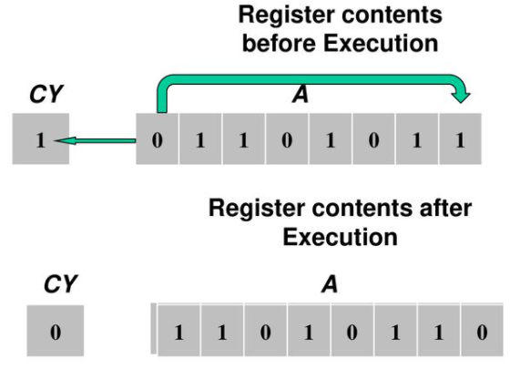
16. RLC
Introduction to Microprocessor Based Systems Design
Rotate accumulator left.
States: 4
Flags: CS
Addressing: Implicit
Machine Cycles: 1
61

Slide 62
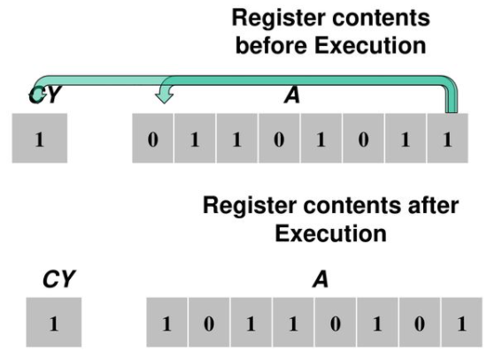
17. RRC
Introduction to Microprocessor Based Systems Design
Rotate accumulator right.
States: 4
Flags: CS
Addressing: Implicit
Machine Cycles: 1
62

Slide 63
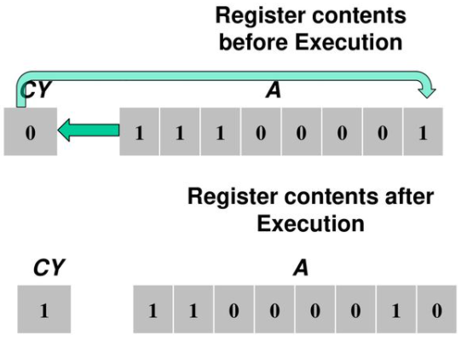
18. RAL
Introduction to Microprocessor Based Systems Design
Rotate accumulator left through carry.
States: 4
Flags: CS
Addressing: Implicit
Machine Cycles: 1
63

Slide 64
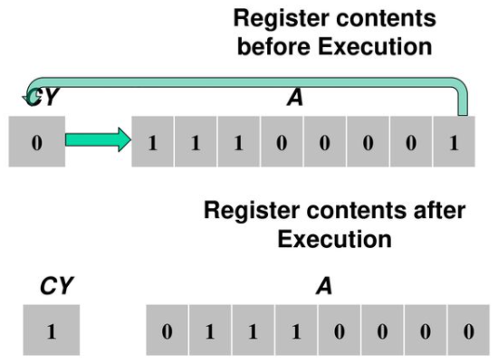
19. RAR
Introduction to Microprocessor Based Systems Design
Rotate accumulator right through carry.
States: 4
Flags: CS
Addressing: Implicit
Machine Cycles: 1
64

Slide 66
8085 Microprocessor
Dr. Manju Khurana
Assistant Professor, CSED
TIET, Patiala
manju.khurana@thapar.edu

Slide 67
Introduction to Microprocessor Based Systems Design
67

Slide 68
Introduction to Microprocessor Based Systems Design
68

Slide 69
Introduction to Microprocessor Based Systems Design
69

Slide 70
Introduction to Microprocessor Based Systems Design
70

Slide 71
Introduction to Microprocessor Based Systems Design
71

Slide 74
8085 Microprocessor
Dr. Manju Khurana
Assistant Professor, CSED
TIET, Patiala
manju.khurana@thapar.edu

Slide 75
Branch Control Group
Introduction to Microprocessor Based Systems Design
The instructions of this group change the normal sequential flow of the program.
These instructions alter either unconditionally or conditionally.
3 categories are there:
JUMP instructions: JMP addr., Conditional JMP instructions, PCHL
Call and return instructions: Call addr., Conditional call instructions, RET, Conditional RET instructions
Restart instructions: RST N
75

Slide 76
1. Jump Conditionally
Introduction to Microprocessor Based Systems Design
Opcode | Description | Status Flags
JC | Jump if Carry | CY = 1
JNC | Jump if No Carry | CY = 0
JP | Jump if Positive | S = 0
JM | Jump if Minus | S = 1
JZ | Jump if Zero | Z = 1
JNZ | Jump if No Zero | Z = 0
JPE | Jump if Parity Even | P = 1
JPO | Jump if Parity Odd | P = 0
76

Slide 77
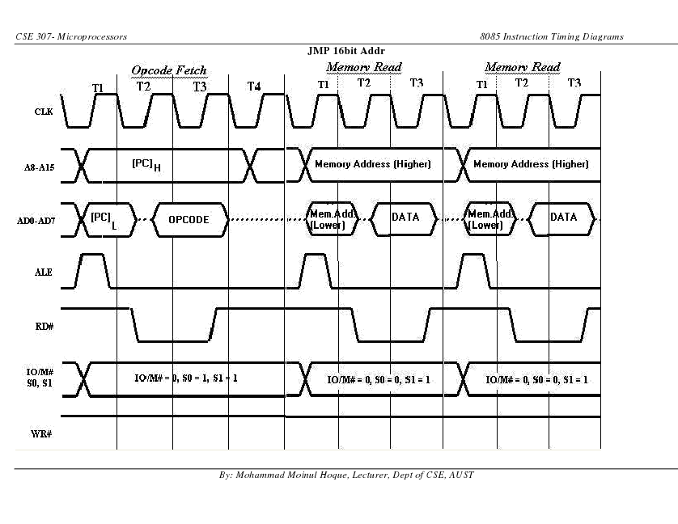
1. JMP addr (label)
Introduction to Microprocessor Based Systems Design
Unconditional jump: jump to the
Instruction specified by the address
[PC] ← Label
States: 10
Flags: None
Addressing: Immediate
Machine Cycles: 3
77

Slide 78
2. Conditional JMP addr (label)
Introduction to Microprocessor Based Systems Design
[PC] ← address (Label)
States: 7/10
Flags: None
Addressing: Immediate
Machine Cycles: 2/3
78

Slide 79
2. Conditional JMP addr (label)contd.
Introduction to Microprocessor Based Systems Design
[PC] ← address (Label)
States: 7/10
Flags: None
Addressing: Immediate
Machine Cycles: 2/3
79

Slide 80
2. Call Conditionally
Introduction to Microprocessor Based Systems Design
Opcode | Description | Status Flags
CC | Call if Carry | CY = 1
CNC | Call if No Carry | CY = 0
CP | Call if Positive | S = 0
CM | Call if Minus | S = 1
CZ | Call if Zero | Z = 1
CNZ | Call if No Zero | Z = 0
CPE | Call if Parity Even | P = 1
CPO | Call if Parity Odd | P = 0
80

Slide 81
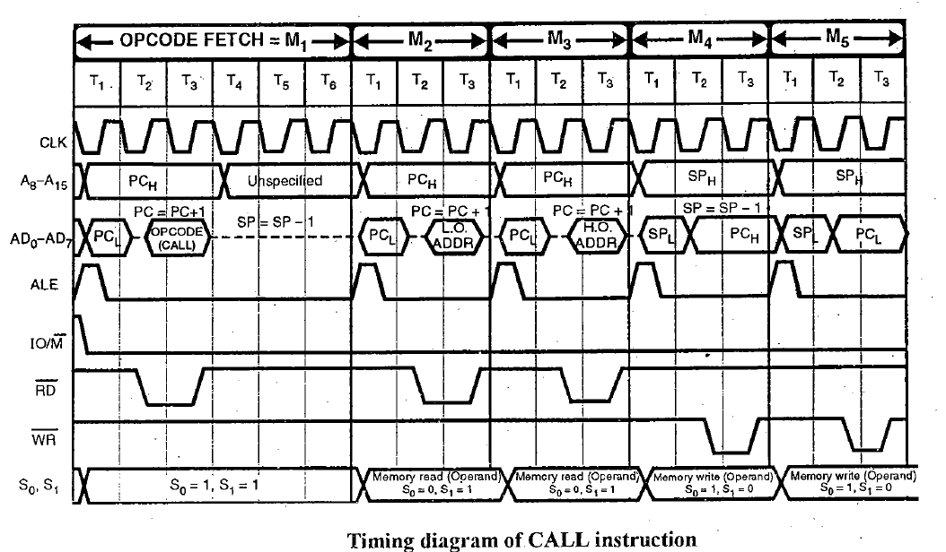
1. CALL addr (label)
Introduction to Microprocessor Based Systems Design
Unconditional call: call the Sub-
routine identified by the address
(PC)_{H} → (SP - 1)
(PC)_{L} → (SP - 2)
(SP – 2) → SP
[PC] ← address (Label)
States: 18
Flags: None
Addressing: Immediate/
Register Indirect
Machine Cycles: 5
81

Slide 82
2. Conditional CALL addr (label)
Introduction to Microprocessor Based Systems Design
(PC)_{H} → (SP - 1)
(PC)_{L} → (SP - 2)
(SP – 2) → SP
[PC] ← address (Label)
States: 9/18
Flags: None
Addressing: Immediate/
Register Indirect
Machine Cycle: 2/5
82

Slide 83
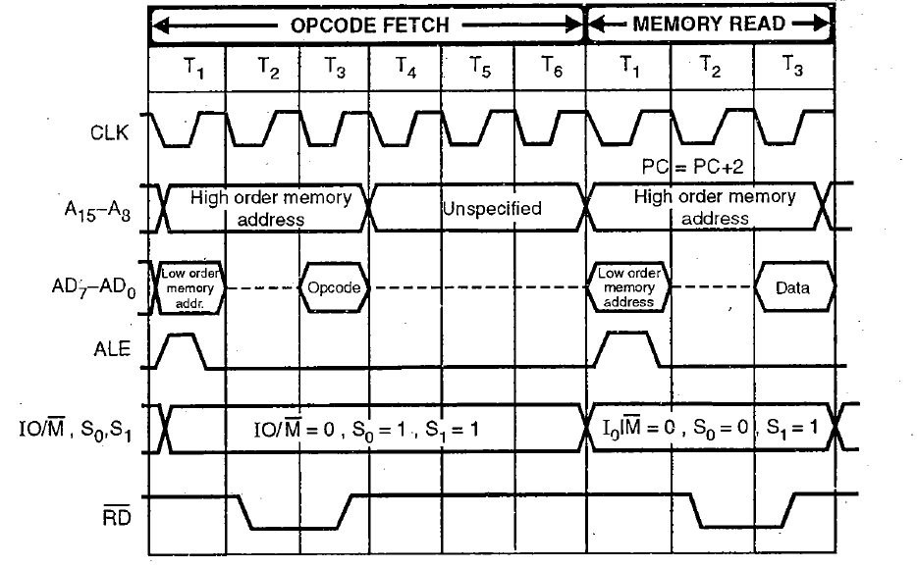
2. Conditional CALL addr (label)contd.
Introduction to Microprocessor Based Systems Design
(PC)_{H} → (SP - 1)
(PC)_{L} → (SP - 2)
(SP – 2) → SP
[PC] ← address (Label)
States: 9/18
Flags: None
Addressing: Immediate/
Register Indirect
Machine Cycle: 2/5
83

Slide 84
3. Return Conditionally
Introduction to Microprocessor Based Systems Design
Opcode | Description | Status Flags
RC | Return if Carry | CY = 1
RNC | Return if No Carry | CY = 0
RP | Return if Positive | S = 0
RM | Return if Minus | S = 1
RZ | Return if Zero | Z = 1
RNZ | Return if No Zero | Z = 0
RPE | Return if Parity Even | P = 1
RPO | Return if Parity Odd | P = 0
84

Slide 85
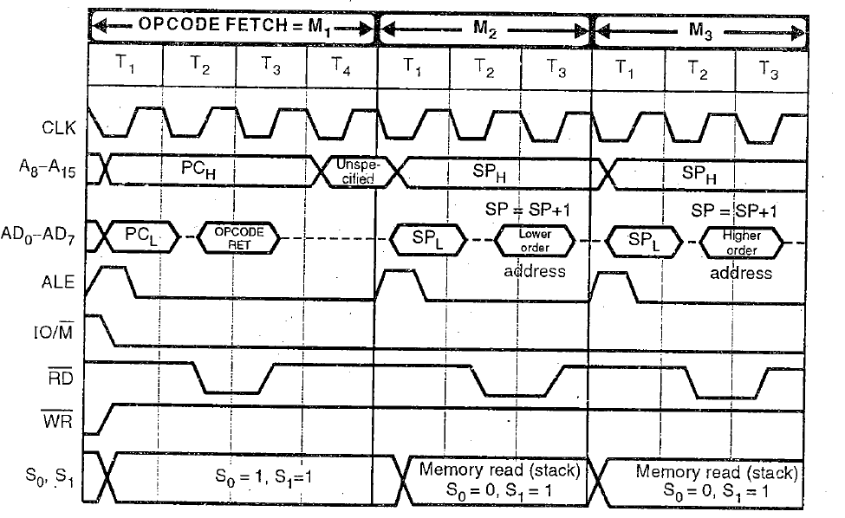
1. RET
Introduction to Microprocessor Based Systems Design
Return from subroutine
(SP) → (PC)_{L}
(SP + 1) → (PC)_{H}
(SP + 2) → SP
States: 10
Flags: None
Addressing: Register Indirect
Machine Cycles: 3
85

Slide 86
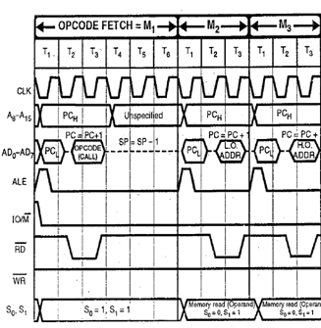
2. Conditional RET
Introduction to Microprocessor Based Systems Design
(SP) → (PC)_{L}
(SP + 1) → (PC)_{H}
(SP + 2) → SP
States: 6/12
Flags: None
Addressing: Register Indirect
Machine Cycles: 1/3
86

Slide 87
2. Conditional RET contd.
Introduction to Microprocessor Based Systems Design
(SP) → (PC)_{L}
(SP + 1) → (PC)_{H}
(SP + 2) → SP
States: 6/12
Flags: None
Addressing: Register Indirect
Machine Cycles: 1/3
87

Slide 88
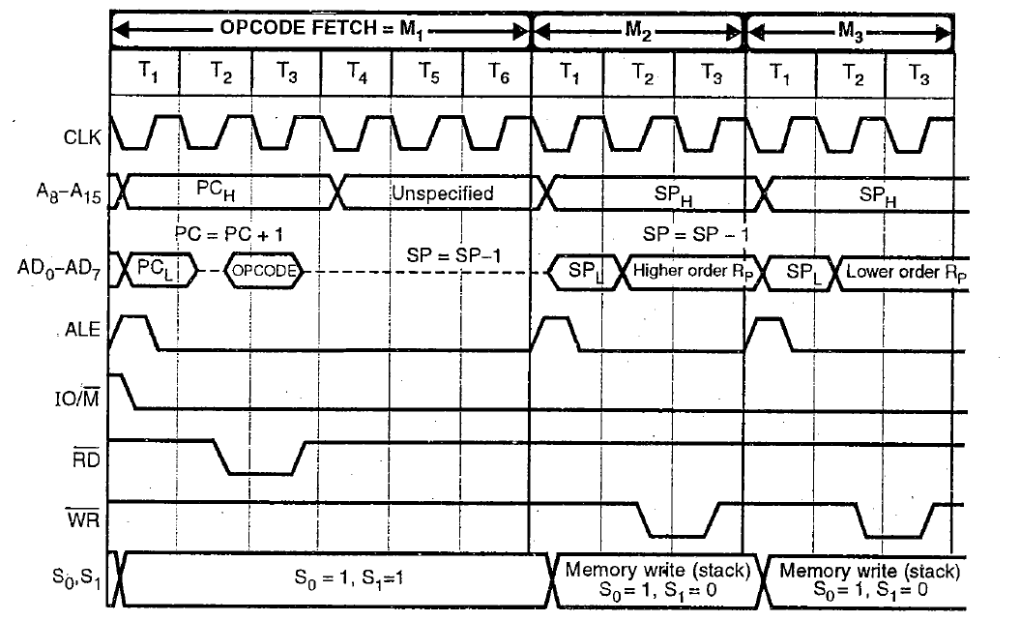
4. RST n (Restart)
Introduction to Microprocessor Based Systems Design
States: 12
Flags: None
Addressing: Register Indirect
Machine Cycles: 3
Instructions | Restart Address
RST 0 | 0000 H
RST 1 | 0008 H
RST 2 | 0010 H
RST 3 | 0018 H
RST 4 | 0020 H
RST 5 | 0028 H
RST 6 | 0030 H
RST 7 | 0038 H
Restart Address
Table
88

Slide 89
5. PCHL
Introduction to Microprocessor Based Systems Design
Jump to address specified by
H-L pair
[PC] ← [H-L]
[PCH] ← [H]
[PCL] ← [L]
States: 6
Flags: None
Addressing: Register
Machine Cycles: 1
89

Slide 91
8085 Microprocessor
Dr. Manju Khurana
Assistant Professor, CSED
TIET, Patiala
manju.khurana@thapar.edu

Slide 92
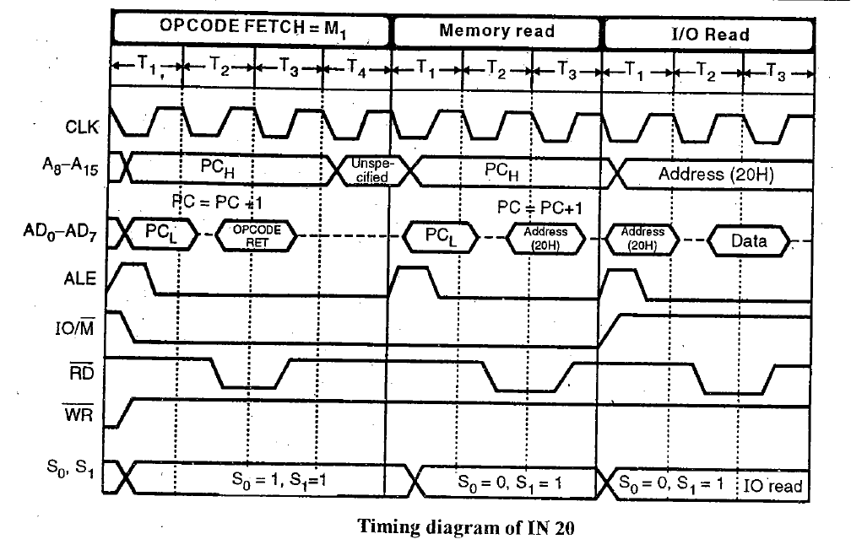
1. IN port-address
Introduction to Microprocessor Based Systems Design
Stack, I/O and Machine Control Group
Input to accumulator from I/O port.
[A] ← [port]
States: 10
Flags: None
Addressing: Direct
Machine Cycles: 3
92

Slide 93
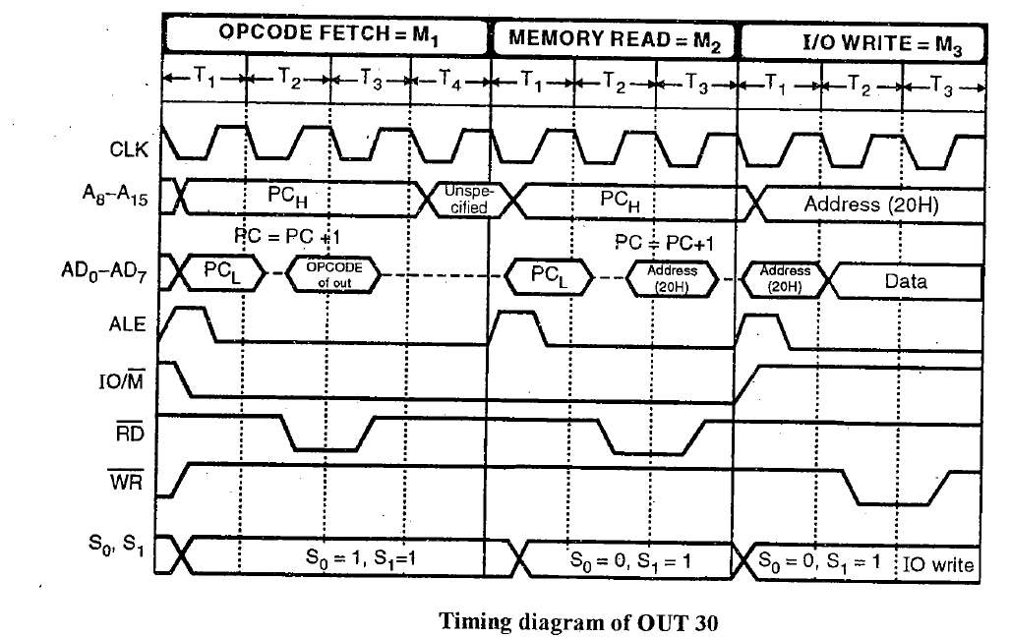
2. OUT port-address
Introduction to Microprocessor Based Systems Design
Output from accumulator to I/O port.
[port] ← [A]
States: 10
Flags: None
Addressing: Direct
Machine Cycles: 3
93

Slide 94
3. PUSH Rp
Introduction to Microprocessor Based Systems Design
Push the content of register
pair to stack.
(Rp)_{H} → (SP – 1)
(Rp)_{L} → (SP – 2)
(SP – 2) → SP
States: 12
Flags: None
Addressing: Register (Source)
Register Indirect (Destination)
Machine Cycles: 3
94

Slide 95
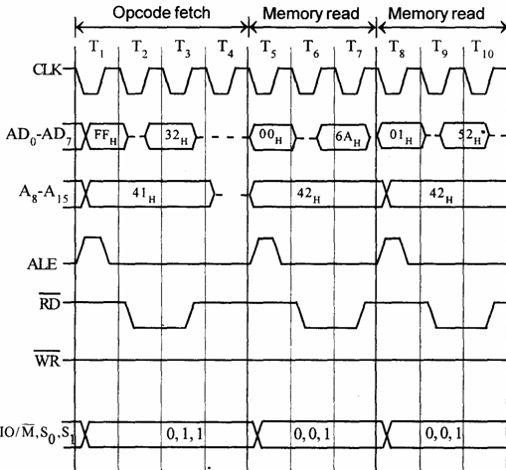
4. POP Rp
Introduction to Microprocessor Based Systems Design
Copy two bytes from the top of
the stack into the specified register.
SP → (Rp)_{L}
(SP + 1) → (Rp)_{H}
(SP + 2) → SP
States: 10
Flags: None
Addressing: Register (Destination)
Register Indirect (Source)
Machine Cycles: 3
95

Slide 96
5. PUSH PSW
Introduction to Microprocessor Based Systems Design
Push processor status word.
[A] → (SP – 1)
PSW → (SP – 2)
(SP – 2) → SP
States: 12
Flags: None
Addressing: Register (Source)
Register Indirect (Destination)
Machine Cycles: 3
96

Slide 97
6. POP PSW
Introduction to Microprocessor Based Systems Design
Copy two bytes from the top of the
stack into PSW and accumulator.
SP → PSW
(SP + 1) → [A]
(SP + 2) → SP
States: 10
Flags: None
Addressing: Register Indirect
Machine Cycles: 3
97

Slide 98
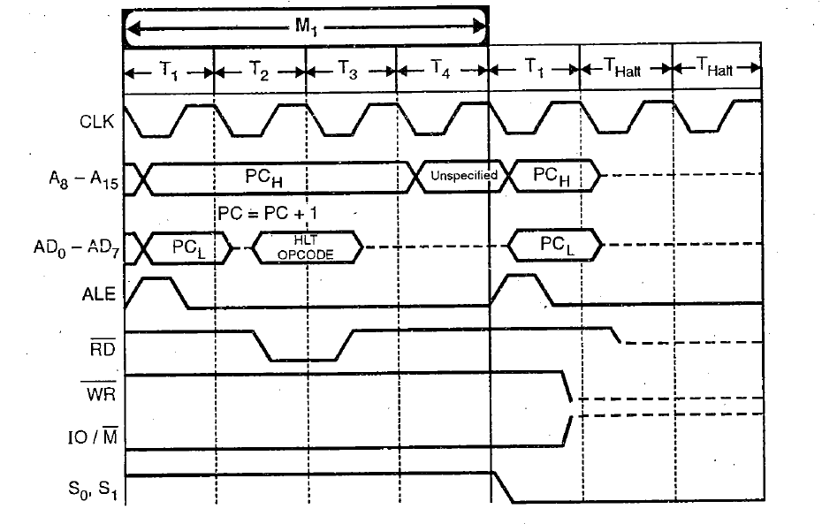
7. HLT
Introduction to Microprocessor Based Systems Design
Halt.
States: 5
Flags: None
Machine Cycles: 1
98

Slide 99
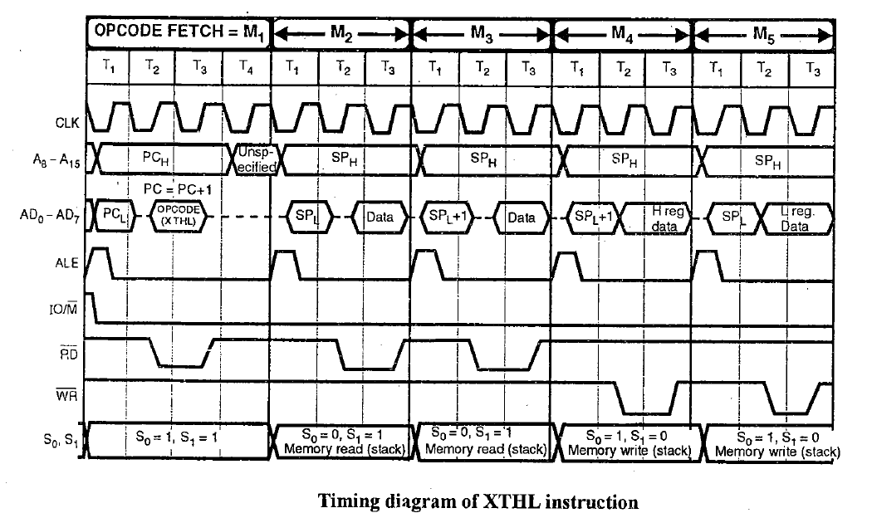
8. XTHL
Introduction to Microprocessor Based Systems Design
Exchange stack-top with H-L.
[L] ↔ [SP]
[H] ↔ [SP+1]
States: 16
Flags: None
Addressing: Register Indirect
Machine Cycles: 5
99

Slide 100
9. SPHL
Introduction to Microprocessor Based Systems Design
Move the contents of H-L
Pair to stack pointer.
[H-L] → [SP]
States: 6
Flags: None
Addressing: Register
Machine Cycles: 1
100

Slide 101
10. EI
Introduction to Microprocessor Based Systems Design
Enable Interrupts.
States: 4
Flags: None
Machine Cycles: 1
101

Slide 102
11. DI
Introduction to Microprocessor Based Systems Design
Disable Interrupts.
States: 4
Flags: None
Machine Cycles: 1
102

Slide 103
12. SIM
Introduction to Microprocessor Based Systems Design
Set Interrupt Mask.
States: 4
Flags: None
Machine Cycles: 1
103

Slide 104
13. RIM
Introduction to Microprocessor Based Systems Design
Read Interrupt Mask.
States: 4
Flags: None
Machine Cycles: 1
104

Slide 105
14. NOP
Introduction to Microprocessor Based Systems Design
No Operation.
States: 4
Flags: None
Machine Cycles: 1
105

